Slide 1
American Sign Language Detection
Tejashree Rajagopalan

Slide 2
Index
Introduction
Problem Statement
Project Overview
Methodology
Image Acquisition And Pre-Processing
Feature Extraction and Classification
ASL With CNN
ASL With Random Forest
Challenges
Future scope
Conclusion

Slide 3
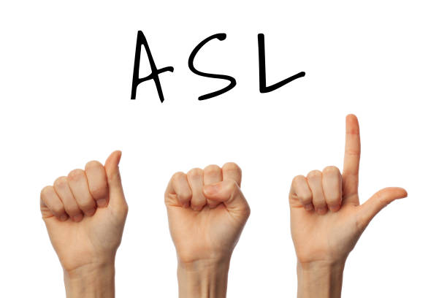
Introduction
American Sign Language (ASL) is a vibrant and expressive visual language used by the Deaf and hard-of-hearing community in the United States.
It is based on hand movements and facial expressions. It is a rich and expressive communication style that employs emotions and body language to communicate messages.
Our project is designed to harmonize with the diverse aspects of sign language communication. We aim to provide tools that enhance communication effectiveness through gestures, encompassing static hand signals, facial expressions, and potentially dynamic hand motions in the future.

Slide 4

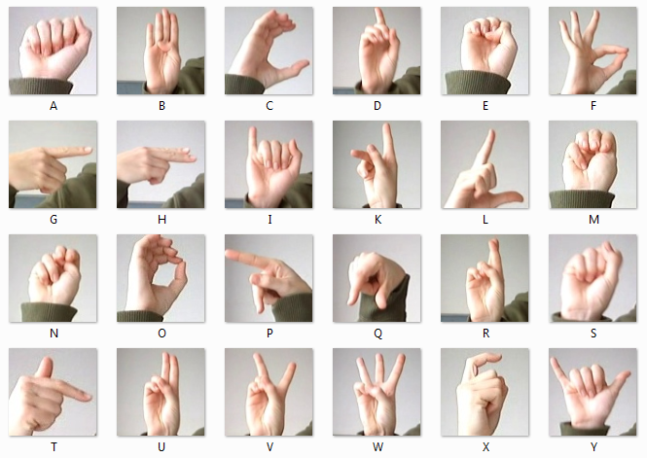

Slide 5
Problem Statement
Existing ASL detection technologies lack precision and efficiency, hindering seamless communication for the Deaf and hard-of-hearing community.
Inaccuracies in ASL detection impede the quality of interactions, limiting the ability of individuals to express themselves effectively.
There is a pressing need for advancements in computer vision, image recognition, and gesture analysis to create a more accurate and responsive ASL detection solution.
Addressing this problem is crucial for fostering inclusivity and enhancing the overall communication experience for individuals using American Sign Language.

Slide 6
Project Overview
Our goal is to develop technological solutions that enhance understanding and recognition of American Sign Language (ASL) gestures.
Utilize Convolutional Neural Networks (CNN) for analyzing static images.
Implemented ASL alphabet recognition using Random Forest Classifier
Sign language involves facial expressions, body movements, and hand gestures for meaning and context.
We recognize the importance of dynamic hand motions in communication but is beyond the scope of this project.

Slide 7
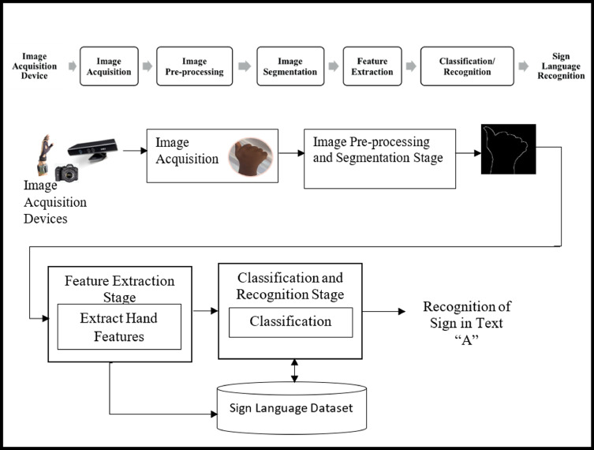
Methodology

Slide 8
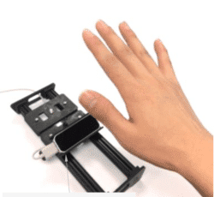
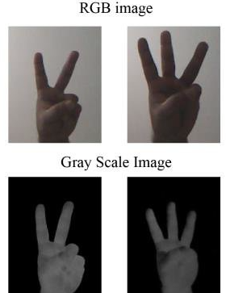
Image Acquisition
Image acquisition is the process of sampling signals that measure real world physical phenomenon and converting them into a digital form that can be manipulated by a software
Image Pre Processing
A preliminary processing of data to prepare it for primary processing or for further analysis. The term can be applied for any first or preparatory processing stage when there are several steps to prepare data for the user.

Slide 9
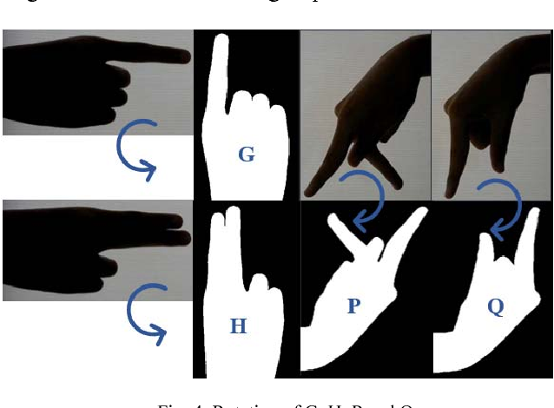
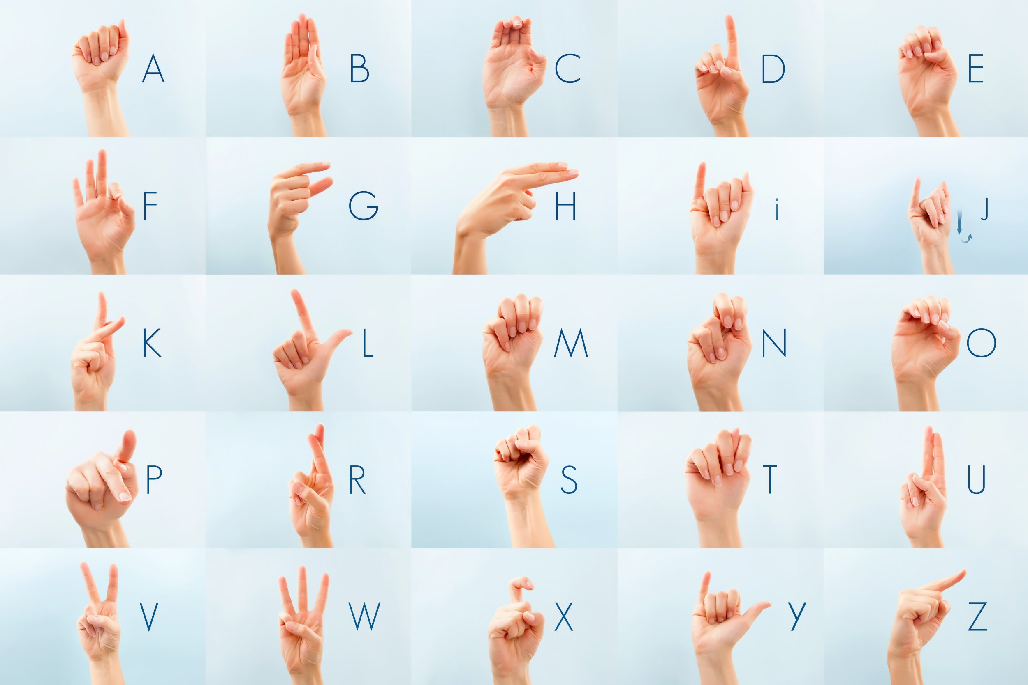
Feature Extraction
Feature extraction plays a crucial role in sign language recognition, enabling accurate interpretation of manual gestures and movements used in sign languages.
Classification
It involves the identification and categorization of different sign language gestures.

Slide 10
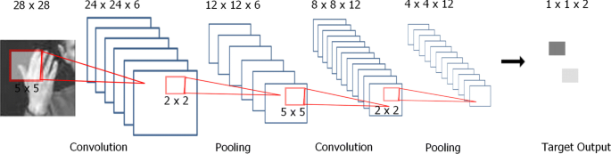
ASL With CNN
The focus of this endeavor involves employing machine learning, specifically Convolutional Neural Networks (CNNs), to tackle sign language classification.
Dataset
Sign Language Dataset Contains grayscale images of hand gestures representing individual letters from the ASL alphabet.
Each image is 28x28 pixels, and the dataset includes labels corresponding to each image.
Utilized libraries like Pandas, NumPy, Matplotlib and modules from Keras for preparing the dataset for further processing
Class names are defined for the 24 alphabets represented in sign language in the dataset.

Slide 11
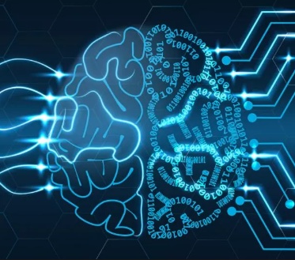
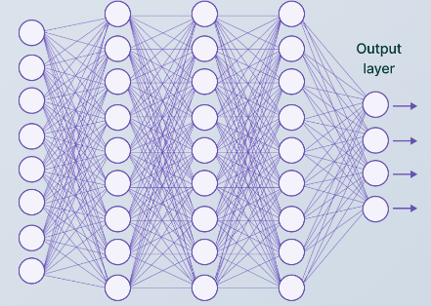
Model Training
Pixel values are normalized to a 0-1 range. Categorical labels become one-hot encoded vectors. Input data reshaping matches the neural network's expected shape. A Keras sequential model with Convolutional layers is then defined.
Layer Description
The architecture includes Conv2D layers with 32, 64, and 128 filters, each using a 3x3 kernel and ReLU activation.
MaxPooling2D layers down sample features, reducing spatial dimensions, while Dropout layers (at 20% rate) prevent overfitting by dropping neurons during training.
These are followed by Flatten to transform the output into a 1D vector for Dense layers: one with 128 neurons (ReLU activation) and a final Softmax layer with 25 neurons, representing classes and providing classification probabilities.

Slide 12
Activation Function
Activation functions in Convolutional Neural Networks (CNNs) introduce non-linearity to the model, allowing it to learn complex patterns and make more sophisticated predictions.
ReLU (Rectified Linear Unit) introduces non-linearity by zeroing negative values in Conv2D and Dense layers, excluding the output layer.
SoftMax in the final Dense layer creates class probabilities for precise predictions. to_categorical() transforms categorical labels to one-hot encoded vectors for Keras training.
model.add() sequentially adds Conv2D, MaxPooling2D, Dropout, and Dense layers.
model.compile() configures the model with loss, optimizer, and metrics.
Finally, model.fit() trains the model with defined epochs, batch size, and validation data.

Slide 13
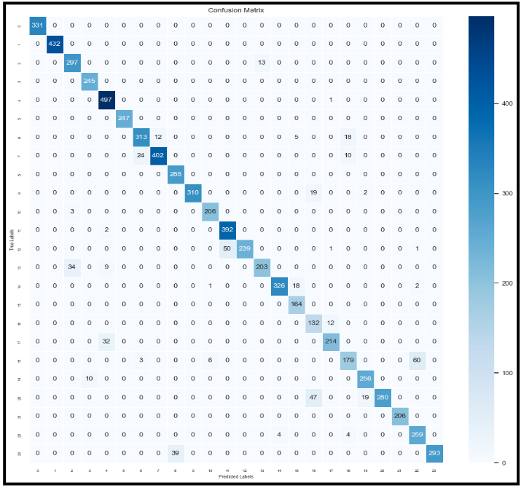
CNN Confusion Matrix

Slide 14
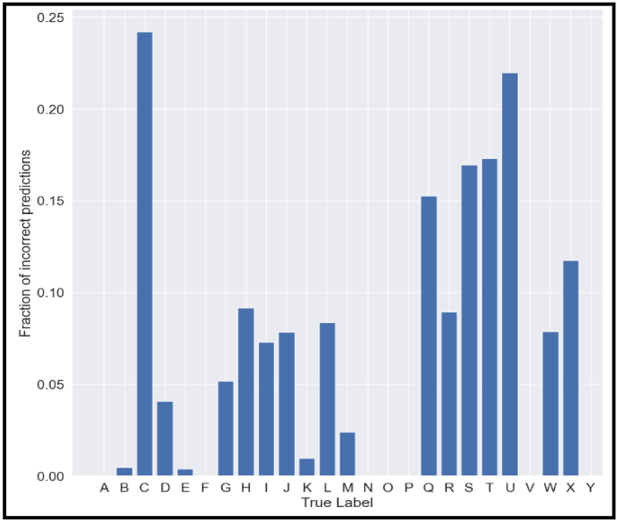
CNN RESULTS
Training Loss Progression:
Epoch 1: Begins at 2.5015, decreases progressively. Epoch 10: Drops to 0.0719, reflecting reduced errors as the model learns data patterns.
Validation Loss Trend:
Epoch 1: Starts at 1.3530, consistently decreases. Epoch 10: Stabilizes at 0.1910, showcasing the model's generalization to new data.
Training Accuracy Evolution:
Epoch 1: Starts at 0.2334, steadily climbs.
Epoch 10: Peaks at 0.9764, indicating the ratio of accurately predicted labels in the training set.
Validation Accuracy Improvement:
Epoch 1: Commences at 0.5753, notably rises.
Epoch 10: Reaches 0.9357, demonstrating the ratio of correct predictions in the validation set.

Slide 15
ASL With Random Forest
The objective is for the model to analyze each input image and categorize it among the 24 letters within the ASL alphabet.
Dataset
Contains color images of ASL alphabet letters, each image being 640x480 pixels with corresponding labels.
Image Collection Process:
Aggregated 19,200 images (200 images * 24 letters * 4 group members) obtained by each member contributing 200 images per letter.
Utilized OpenCV (opencv) library functions like cv2.VideoCapture(0), cv2.imshow(), cv2.waitKey(), and cv2.imwrite() to initiate webcam feed, display video, wait for input, and save images into directories corresponding to ASL classes.

Slide 16
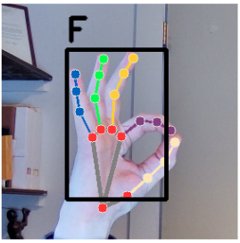
Data Preparation
For data preparation, we utilize the MediaPipe library. This step involves taking images in numpy array format and generating three outputs:
Handedness, indicating whether detected hands are left or right.
Landmarks, comprising 21 hand features like fingertips and joints, with x and y coordinates normalized to [0.0, 1.0] by image width and height, and z representing depth from the wrist.
World Landmarks, providing the same 21 features but in real-world 3D coordinates, with x, y, and z denoting meters from the hand's geometric center.

Slide 17
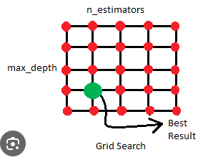
Model Training
Training occurs via model.fit() using the training data.
GridSearchCV explores hyperparameters, identifying optimal settings (e.g., max_depth: 30, min_samples_leaf: 1, min_samples_split: 2, n_estimators: 300) for the ASL gesture recognition Random Forest Classifier model.
Test Prediction
In the prediction loop, the code continuously handles video frames from the webcam (cap) in an infinite loop.
Frame Processing: Each webcam frame undergoes conversion to RGB color space to meet MediaPipe's specifications.
Hand Landmark Detection: MediaPipe analyzes the frame to identify hand landmarks (results = hands.process(frame_rgb)).
Visualization: The detected hand landmarks are visually represented on the frame using mp_drawing.draw_landmarks.

Slide 18
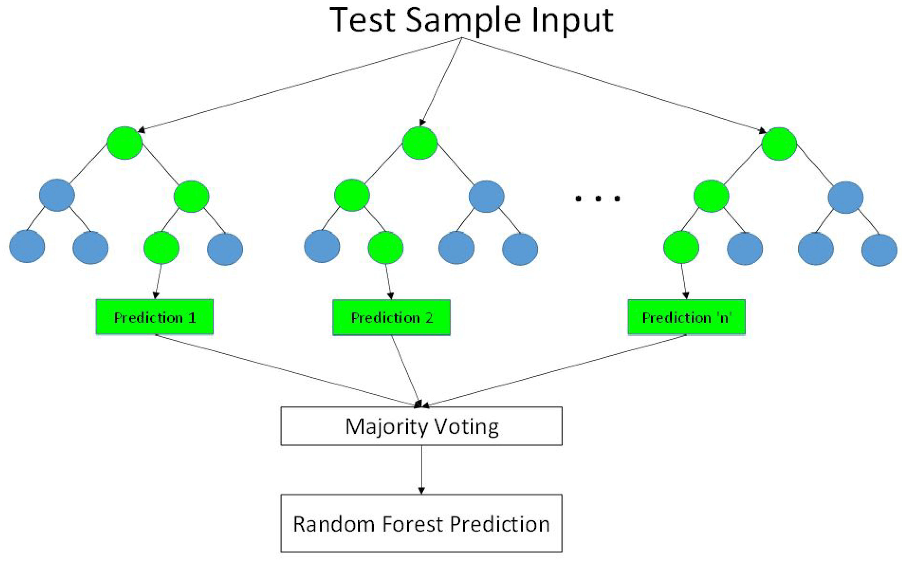
Random Forest Classifier Result Analysis
The Random Forest model scored 99.795% accuracy, slightly better than the CNN's 93.168%. Both performed remarkably well. Metrics like precision, recall, and F1 scores were high and well-balanced. Despite slight differences, indicating some mislabeled categories, overall, the model demonstrated excellent performance.
Precision:
Micro: 99.80%
Macro: 99.80%
Recall:
Micro: 99.80%
Macro: 99.78%
F1 Score:
Micro: 99.80%
Macro: 99.79%

Slide 19
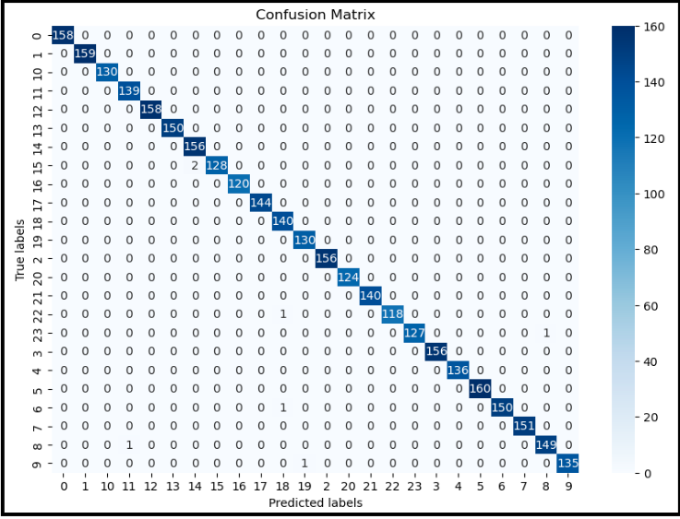
Confusion Matrix
The confusion matrix offers a detailed breakdown of correct and incorrect responses

Slide 20
Key Observations
The model's most frequent misclassification was predicting the letter Q (15) as P (14) twice.
Other sporadic misclassifications included: X (22) as T (18), Y (23) as I (8), G (6) as T (18), I (8) as M (11), and K (9) as U (19).
These misclassifications show no clear trend, indicating minimal to no bias in the model.
While some categories had more misclassifications, 18 out of the 24 categories had no misclassifications, emphasizing the limited impact of these discrepancies.

Slide 21
Challenges
Web Cameras as Alternatives:
Web cameras can serve as viable alternatives to cameras with higher specifications.
However, the quality of captured images may be compromised due to blurriness.
Challenges in Data Collection from Sensors:
Data collection from sensors faces several challenges, including:
1.Noise interference
2.Human handling errors
3.Improper ground connection issues
Limited Datasets for SLR Systems:
The scarcity of readily available large datasets poses challenges for the training and assessment of SLR systems.
Time-Consuming Labeling for Isolated SLR Techniques:
Isolated SLR techniques require meticulous word-by-word labeling, leading to time-consuming processes.

Slide 22
Conclusion
This American Sign Language (ASL) detection system successfully translates sign language gestures and highlights the impressive performance of both CNN and Random Forest Classifier models.
The Random Forest model outperformed the CNN, achieving an accuracy of 99.795% compared to CNN’s 93.168%. Despite the Random Forest model's high accuracy, there is a caveat regarding its training on controlled data, suggesting a potential loss of accuracy with a more diverse dataset.
By continuing to advance the capabilities of SLR systems, we can foster inclusivity, empower individuals with disabilities, and enable effective communication across different sign languages.

Slide 23
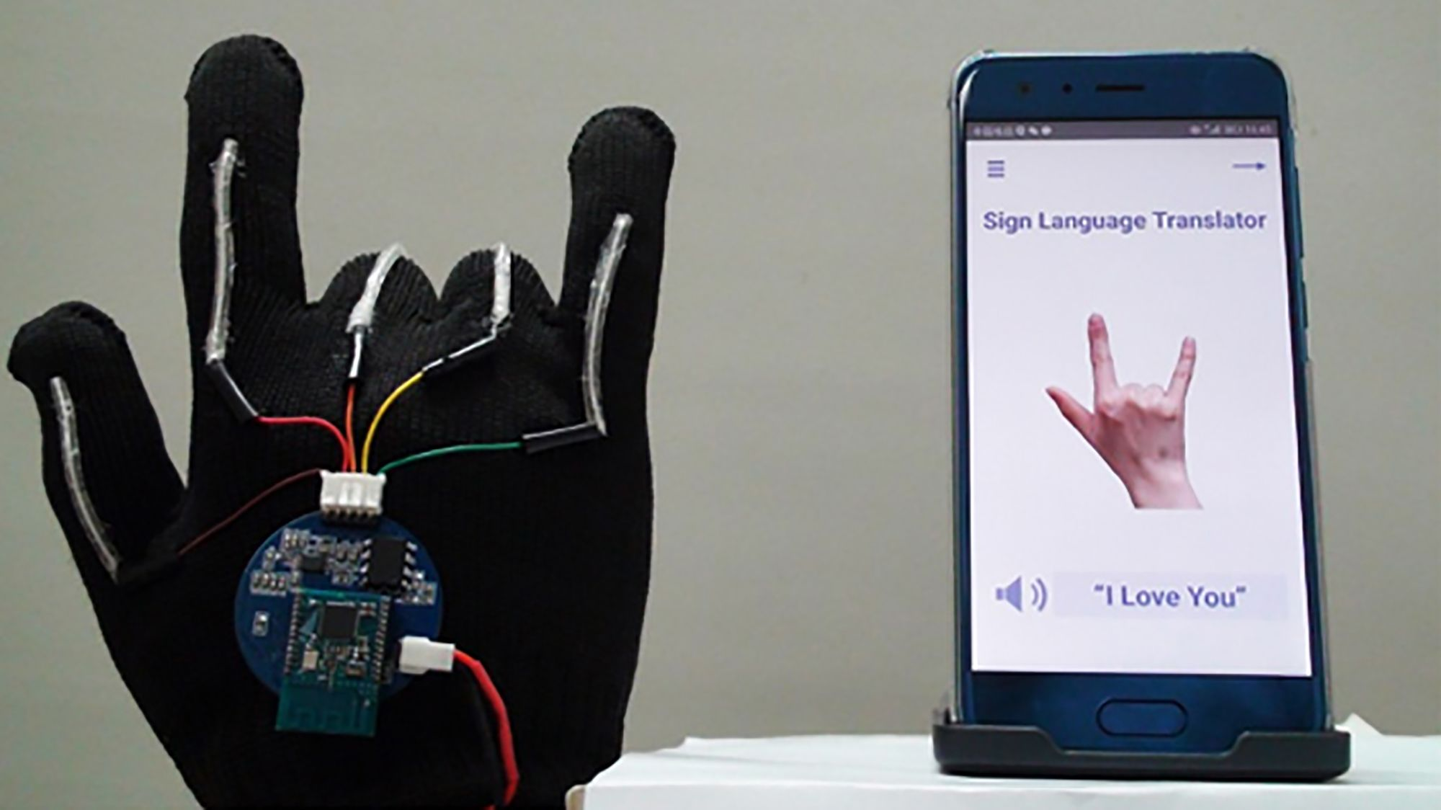
Future Scope
Voice-Integrated Sensor Gloves for Sign Language Recognition:
The focus is on recognizing sign language motions through the combination of hand gestures and voice commands.
Smart Glasses Integrated with SLR Software:
Investigate the integration of Speech-to-Text (SLR) software with smart glasses technology.
SLR Mobile App
The app aims to transcribe spoken words into text, catering to the needs of users who may benefit from visual representation of spoken language.

Slide 24


